Slide 1


Walmart Sales Analysis
Data visualization domain internship
AMAL SALILAN

Slide 2
Walmart Sales Analysis
Our project analyzes Walmart’s sales data to uncover customer buying patterns and trends. The goal is to enhance Walmart’s strategic planning, marketing efforts, and product management while improving the shopping experience for customers.

Slide 3
AGENDA
Introduction
Dataset outline
Tech Stack
Exploratory Data Analysis (EDA)
Modeling
Deployment
Challenges
Result and the future scope

Slide 4
Overview
The project is structured around three key objectives:
1. Understanding Customer Groups
Identifying different types of customers based on their purchasing behavior, such as high-spending or frequent buyers. Using these insights to offer personalized deals, discounts, and services that cater to specific customer needs.
2. Predicting Future Sales
Analyzing past sales trends to estimate future sales and profit figures. Helping Walmart anticipate customer demand and prepare for peak shopping periods.
3. Improving the Customer Experience
Utilizing data-driven insights to ensure products are available when needed. Providing tailored promotions and a seamless shopping experience.

Slide 5
Methodology:
Preparing the Data
Collected Walmart’s sales data, including transaction dates, sales amounts, profits, and regional performance. Cleaned and structured the data for effective analysis.
Grouping Customers
Categorized customers based on shopping habits to identify spending patterns. Recognized trends in customer behavior, such as high-value shoppers and frequent buyers.
Predicting Sales
Studied historical sales and profit trends to forecast future performance. Provided insights to help Walmart plan for seasonal demand and promotional events.
Visualizing Results
Created clear and simple charts to illustrate customer segments and sales trends.

Slide 6
DATASET OUTLINE...
About the Data
Time period covered by the data : 4years
Key metrics/headline figures :
Sales, Profit, discount data
Customer demographics &order details
Product hierarchy (category/subcategory)
Shipping & logistics information
Why Walmart Dataset?
Business Relevance
Data Quality & Scope
Analysis Potential
Operational Metrics
Decision Support:
Learning Value
Business Value:
Track sales performance
Analyze customer behaviour
Monitor operational efficiency
Guide pricing strategies

Slide 7
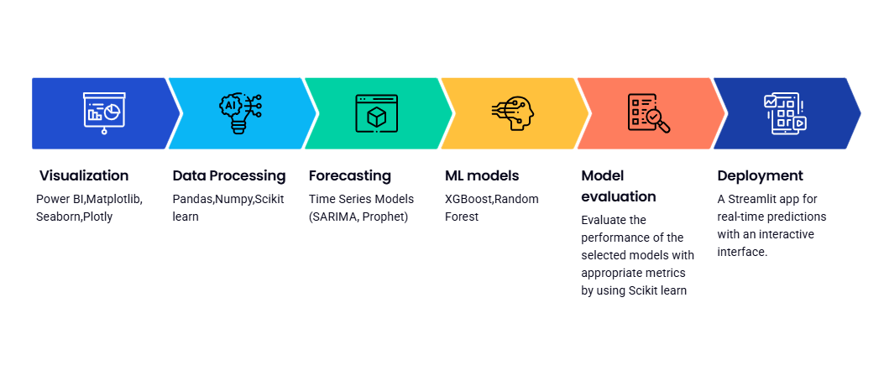
TECH STACK

Slide 8
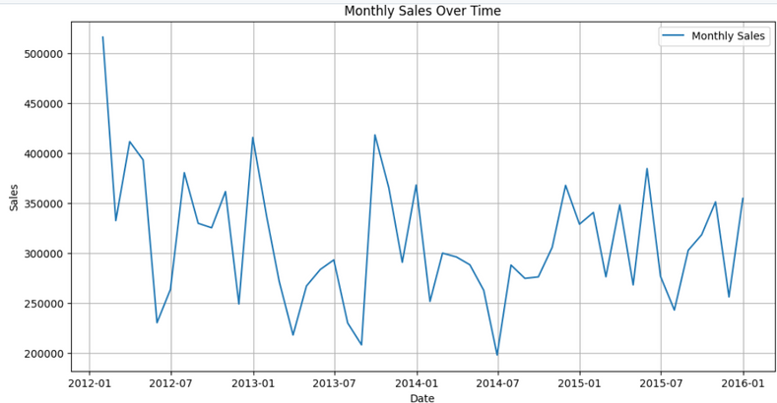
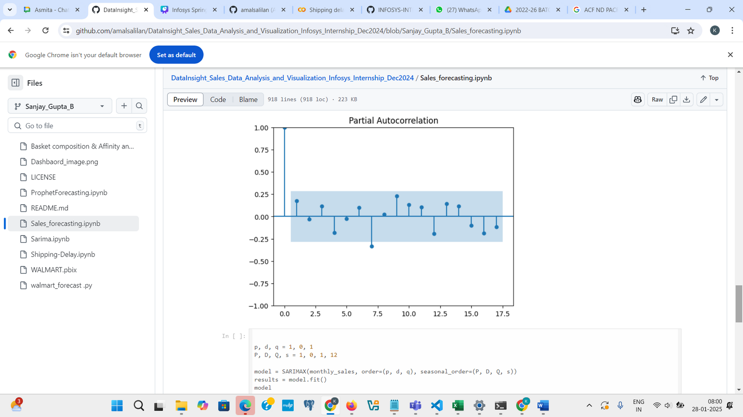
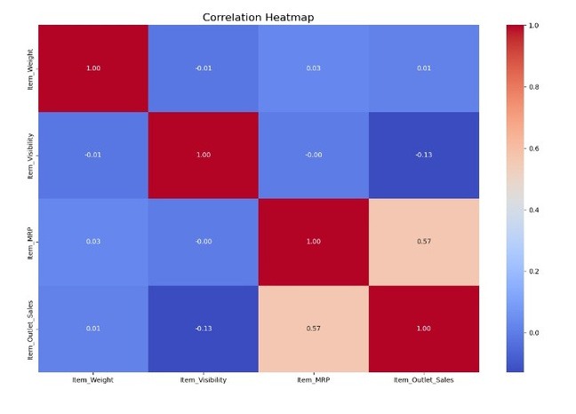
EXPLORATORY DATA ANALYSIS (EDA)
Partial autocorrelation plot
Correlation Heatmap
Line Plot
The x-axis of the plot represents the order date and the y-axis representing the sales amount.
The plot shows an overall downward trend in monthly sales over the period from 2012 to 2016.
Higher sales generally occurring in the first half of each year and lower sales in the second half .
Item MRP and Item_Outlet_Sales have a high positive correlation.
Item Weight and Item_Outlet_Sales have a negligible positive correlation.
Item Visibility and Item_Outlet_Sales have a negative correlation.
The x-axis of the plot represents the lag between the current value and the past value.
The y-axis represents the partial autocorrelation coefficient.
1 indicates perfect positive correlation, -1 indicates perfect negative correlation, and 0 indicates no correlation.

Slide 9
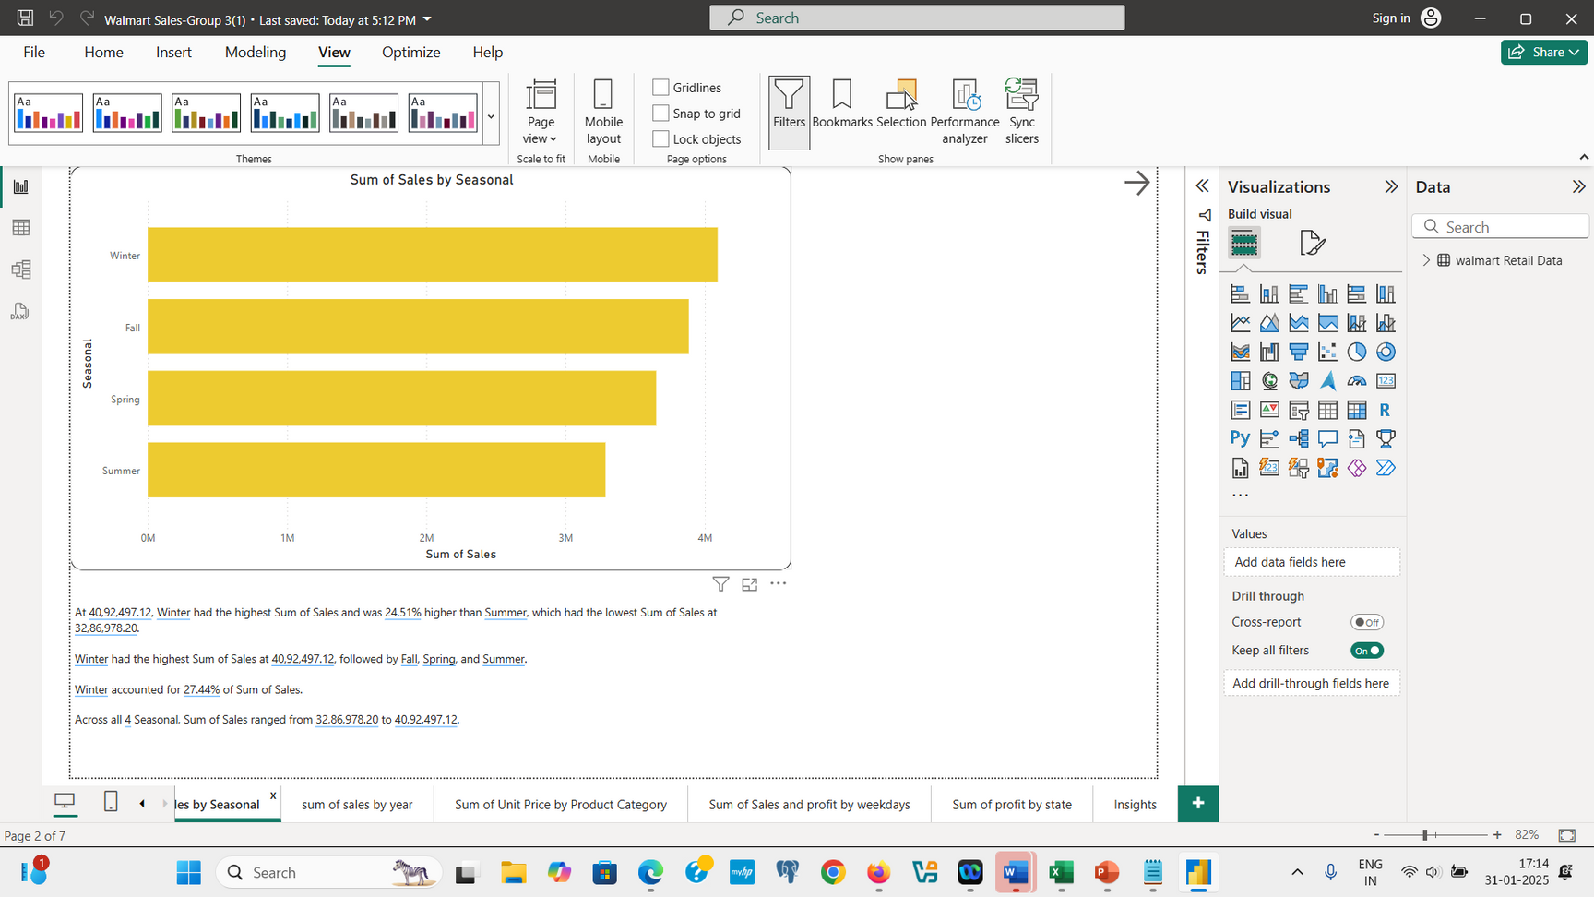
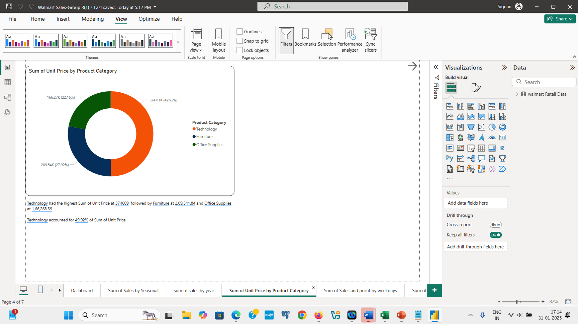
Winter has the highest sales: Winter has the highest sales compared to other seasons, with sales of 40,92,497.12.
Summer has the lowest sales: Summer has the lowest sales, at 32,86,978.20.
Winter sales are 24.51% higher than Summer sales: Winter sales are significantly higher than Summer sales, with a difference of 24.51%.
Sales range across all seasons: Sales range from 32,86,978.20 to 40,92,497.12 across all four seasons.
Technology dominates the market: Technology has the highest sum of unit prices (49.92%) followed by furniture (27.92%) and office supplies (22.16%).
Technology has a significant contribution: The sum of unit prices for Technology is almost double the sum of unit prices for furniture.
Office supplies have the lowest contribution: The plot suggests office supplies have the lowest contribution to the total sum of unit prices.

Slide 10
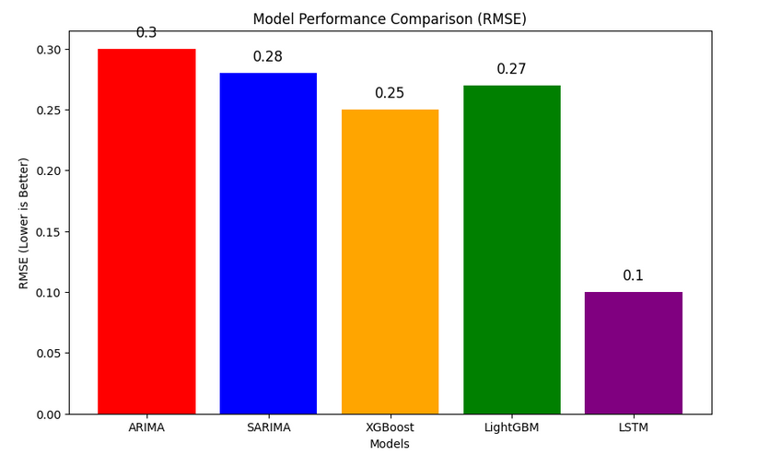
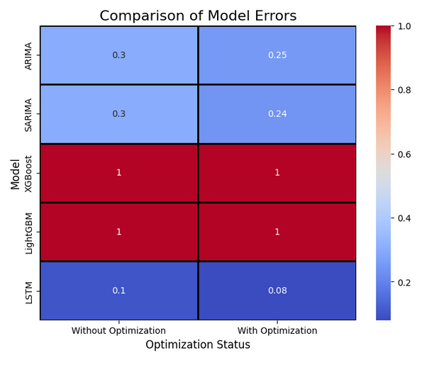
MODELING
✔️ LSTM shows the best improvement with optimization.
✔️ SARIMA improves slightly, benefiting from seasonality handling.
✔️ Boosting models (XGBoost & LightGBM) need evaluation, expected to handle large datasets efficiently.
✔️ Traditional models (ARIMA, SARIMA) show moderate gains, but struggle with complex data patterns.

Slide 11
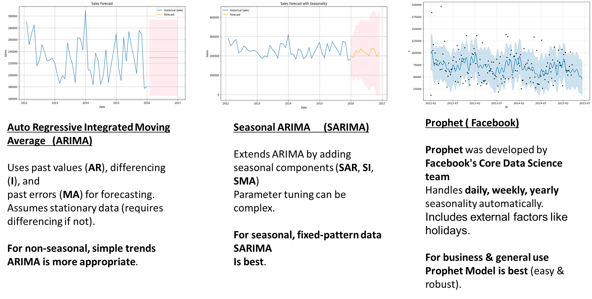
Time Series Forecasting Models

Slide 12
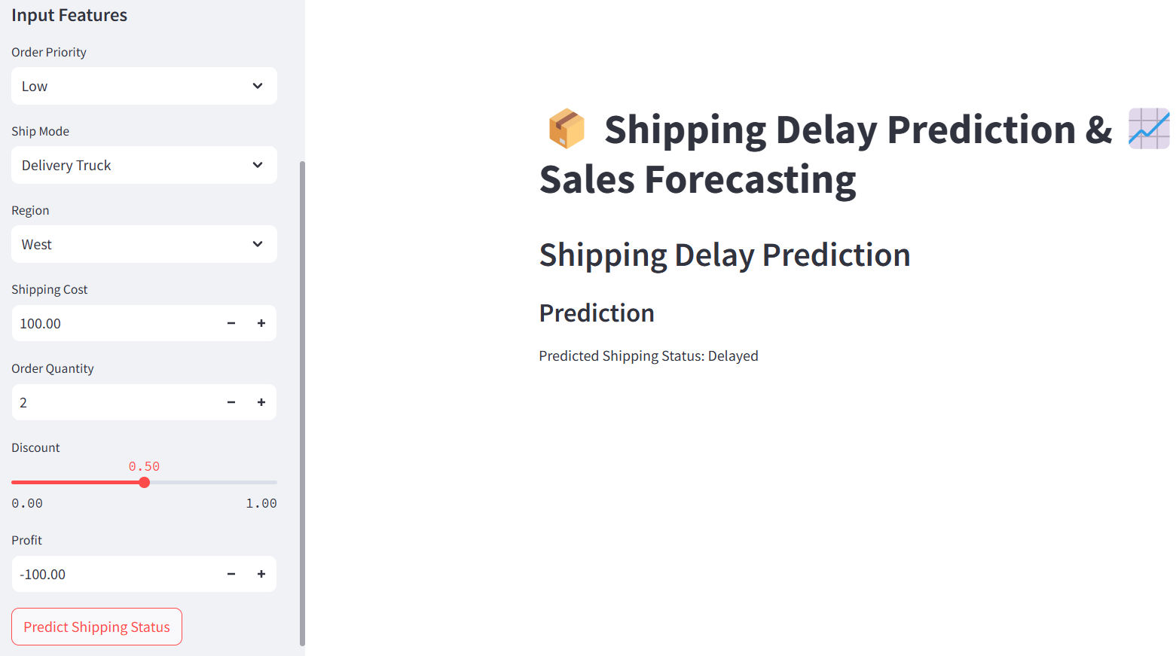
User Interface for Shipping Delay Prediction
Created an interactive Streamlit interface that allows users to input shipping parameters and receive real-time predictions on potential delays.

Slide 13
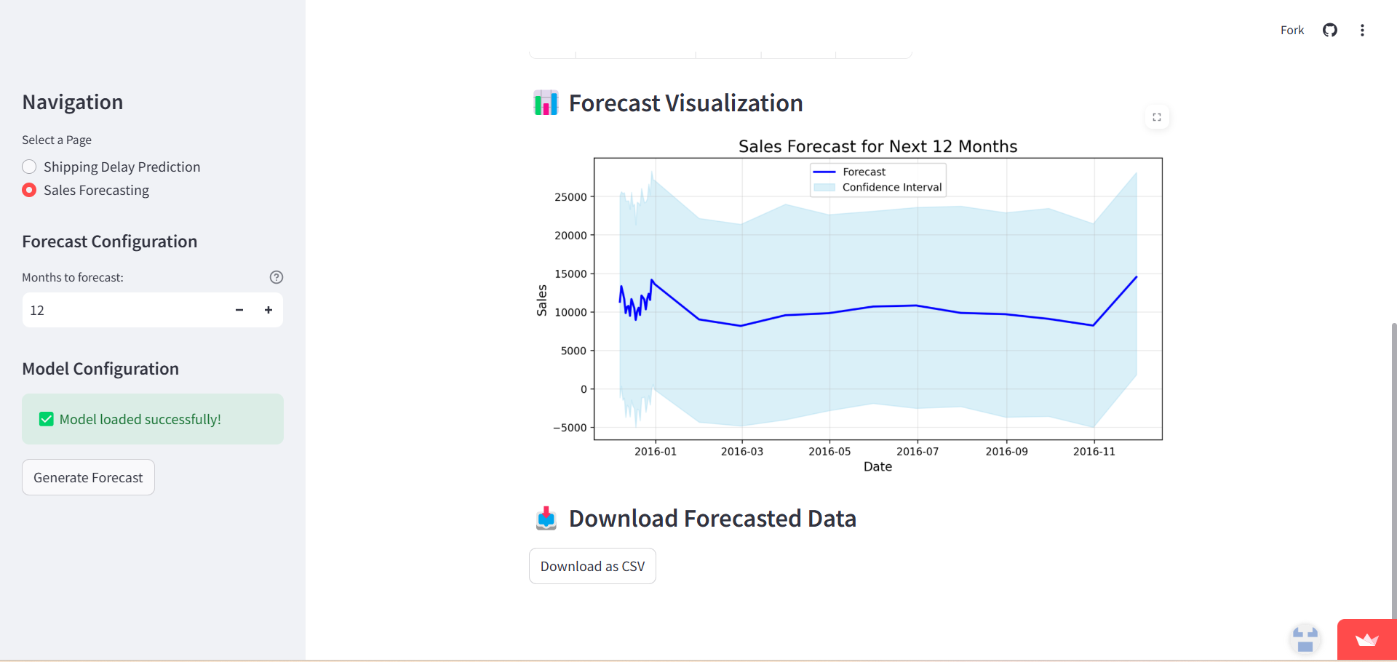
User Interface for Sales forecasting
Developed a user-friendly interface with Streamlit, allowing users to input data, generate real-time sales forecasts, and explore trends through interactive visualizations.

Slide 14
Results
Forecasted sales trends using SARIMA to anticipate demand.
Predicted shipping delays with machine learning for better logistics.
Identified customer segments for personalized marketing.
Created interactive visualizations in Power BI and Streamlit.
Provided insights to optimize inventory and improve efficiency.
Future Scope
Enhance models with deep learning, enable real-time predictions, automate decisions, analyze broader data, and scale to other retailers.

Slide 15
Thank you!

